Slide 1
Subject : Image and Vision Processing
Topic
Image Compression Fundamentals & Data Redundancy

Slide 2
Subtopics :-
What is an Image ?
What is Image Compression and Data Redundancy ?
Types of Image Compression (Diffrence between Lossless and Lossy Compression)
Types of Redundancy

Slide 3


What is an Image ?
An image is nothing more than a two dimensional signal. It is defined by the mathematical function f(x,y) where x and y are the two co-ordinated horizontally and vertically. The value of f(x,y) at any point gives the pixel value at that point of an image. The world around us is 3D while the image obtain through camera is 2D, hence an image can be defined as “A 2D representation of 3D world”.
Types of Image :-
1) Analog – It can be represented as continuous range of value representing position and intensity.
2) Digital – It is composed of picture element called “Pixel” .
- The figure at right side is an example of digital image that you are now viewing But actually , this image is nothing but a two dimensional array of numbers ranging between 0 and 255.
- Each number represents the value of the function f(x,y) at any point. In this case the value 128 , 230 ,123 each represents an individual pixel value. The dimensions of the picture is actually the dimensions of this two dimensional array.

Slide 4
What is an Image Compression and Data Redundancy ?
Image Compression : It is the art and science of reducing the amount of data required to represent an image.
Image Compression is a type of data compression applied to digital images, and it helps us to save our disk space and time in the data transmission.
The objective of an image compression is to reduce irrelevance and redundancy of an image data in order to be able to store or transmit data in an efficient form.
Why Image Compression :- 1) Ease of Transform 2) Ease of Storage
Data Redundancy :
Redundancy means repetitive data.
Data redundancy is a condition created within a database or data storage technology in which the same piece of data is held in two separate places.
Computer store the images in pixel values so sometimes image has duplicate pixel values or maybe if we remove some of the pixel values they don’t affect on the information of an actual image.
Data Redundancy is one of the fundamental component of Data Compression.

Slide 5
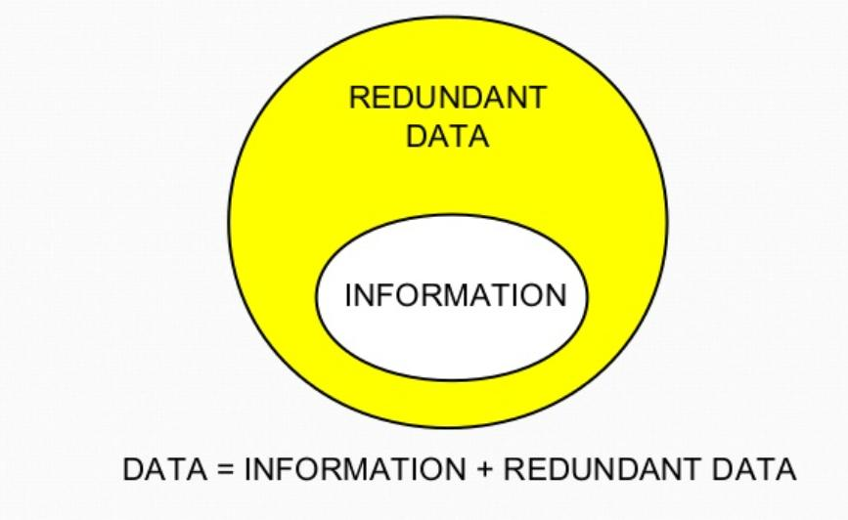
Data can be consists of information and redundant Data. So, we need to remove redundant data in order to obtain a specific information from data.
Data is not the same thing as an information.
Data is the means with which the information is expressed.
The amount of data can be much larger than the amount of information.

Slide 6
Types of Image Compression
Sr.No. | Lossless Data Compression | Lossy Data Compression
1) | In Lossless data compression, there is no loss of any data and quality. | In Lossy data compression, there is a loss of quality and data, which is not measurable.
2) | In lossless, the file is restored in its original form. | In Lossy, the file does not restore in its original form.
3) | Lossless data compression algorithms are : Run Length Encoding Huffman encoding Shannon fano encoding Arithmetic encoding Lempel Ziv Welch encoding etc. | Lossy data compression algorithms are: Transform coding Discrete Cosine Transform Discrete Wavelet Transform fractal compression etc.
4) | Lossless compression is mainly used to compress text-sound and images. | Lossy compression is mainly used to compress audio, video, and images.
5) | As compare to lossy data compression, lossless data compression holds more data. | As compare to lossless data compression, lossy data compression holds less data.
6) | File quality is high in the lossless data compression. | File quality is low in the lossy data compression.
7) | Lossless data compression mainly supports RAW, BMP, PNG, WAV, FLAC, and ALAC file types. | Lossy data compression mainly supports JPEG, GIF, MP3, MP4, MKV, and OGG file types.

Slide 7
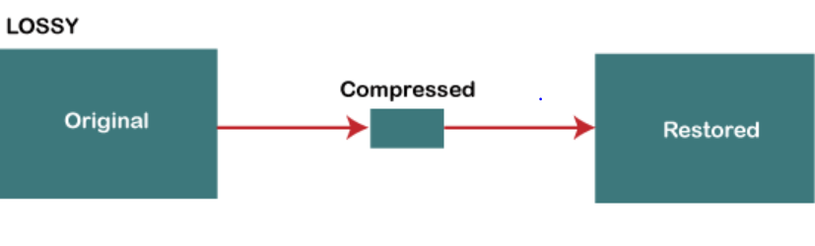
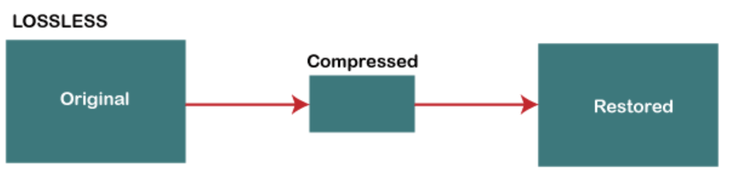
Lossy Data Compression is most widely used in JPEG images, MPEG video, MP3 Audio formats.
Lossless Data Compression mainly used in the sensitive documents, confidential information, and PNG, RAW,GIF,BMP file formats.

Slide 8
Types of Redundancy
Coding Redundancy
Inter-pixel Redundancy
Psychovisual Redundancy

Slide 9
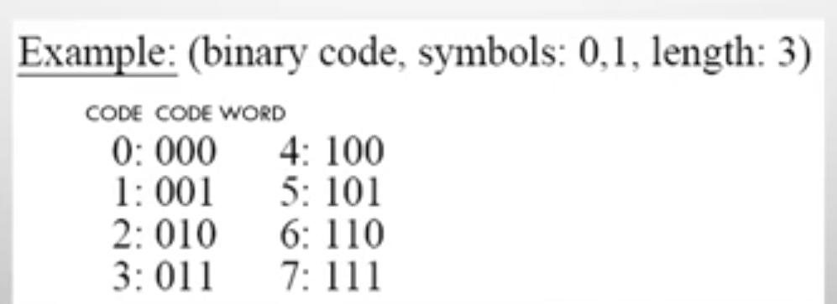
Coding Redundancy :
Coding redundancy is associated with the representation of information.
The information is represented in the form of codes.
If the gray levels of an image are coded in a way that uses more code symbols than absolutely necessary to represent each gray level than the resulting image is said to contain coding redundancy.
Code : A list of symbols (letters, numbers, bits etc).
Code Word : A sequence of symbols used to represent some information (e.g. Gray levels [Used to represent intensity Values])
Code Word Length : Number of symbols in a code word.

Slide 10
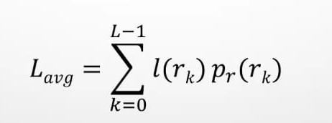
rk -> Input Intensity Value e.g. 0-255 for grayscale image
l(rk) -> No. of bits used to represent rk
Then average no. of bits required to represent each pixel is
Say, Uniform Width structure (all pixels are using 8 bits to represent intensity)
Equal length code (Fixed length code)
m-bit fixed length code (8 bit fixed length code in our case)
In this case, l(rk) = 8 [Each will require 8 bits in fixed length]
Coding Redundancy tries to reduce Lavg
Thus, total no. of bits required to represent an M X N image is M X N X Lavg
The code can be an equal length code, or variable length code.

Slide 11
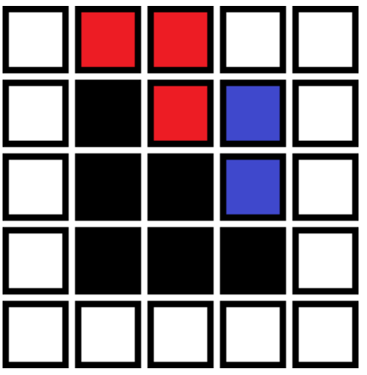
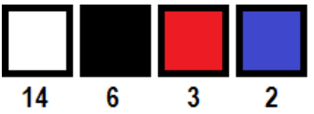
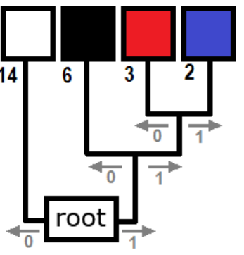
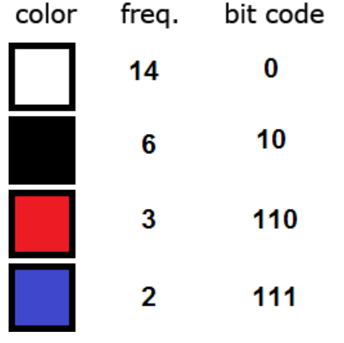
Huffman Coding :
Suppose we have a 5 x 5 raster image with 8-bit color, i.e. 256 different colors.
The uncompressed image will take 5 x 5 x 8 =200 bits of storage.
First, we count up how many times each color occurs in the image. Then we sort the colors in order of decreasing frequency we end up with a row that looks like this :
Now we put the colors together by building a tree such that the colors farthest from the root are the least frequent. The colors are joined in pairs, with a node forming the connection. A node can connect either to another node or to a color. In our example, the tree might look like this:
Our result is known as a Huffman tree. It can be used for encoding and decoding. Each color is encoded as follows. We create codes by moving from the root of the tree to each color. If we turn right at a node, we write a 1, and if we turn left – 0. This process yields a Huffman code table in which each symbol is assigned a bit code such that the most frequently occurring symbol has the shortest code, while the least common symbol is given the longest code.

Slide 12
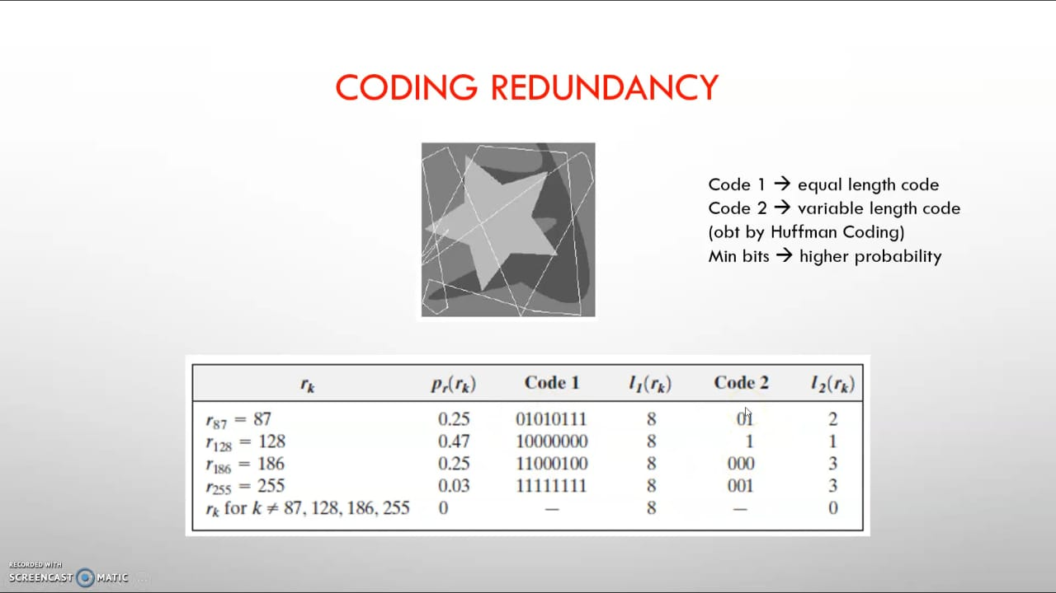

Slide 13
For code1, Lavg = 8
On the other hand, using code 2, the average length of the encoded pixel is :
Lavg = 0.25(2) + 0.47(1) + 0.25(3) + 0.03(3) = 1.81 bits
The resulting compression and corresponding relative redundancy are
Cr = Number of bits required to store image by using Code 1
Number of bits required to store image by using Code 2
= 256 X 256 X 8
256 X 256 X 1.81
= 4.42
R = 1-1/Cr = 1- 1
4.42
= 0.774
Thus, 77.4% of the data in the original 8-bit 2-D intensity array is redundant.
The compression achieved by code 2 results from assigning fewer bits to the more probable intensity values than to the less probable ones

Slide 14
Interpixel Redundancy :
This type of redundancy is related with the inter-pixel correlations within an image.
Much of the visual contribution of a single pixel is redundant and can be guessed from the values of its neighbors. It means the value of the neighbors of an observed pixel can often be
predicted from the value of the observed pixel.
Example :
Consider an image with a constant background
The visual nature of the image background is given by many pixels that are not actually necessary.
This is known as Spatial Redundancy or Geometrical Redundancy
Spatial Redundancy may be present in :
Single Frame (intra-frame)
Or among multiple frames (inter-frame or temporal redundancy)
Intra-frame means that all the compression done within that single frame and Inter-frame referes to as compression that takes place across two or more frames.
Intra-frame requires less processing time Inter-frame requires more processing time.
Inter-pixel redundancy can be solved by algorithms like : Predictive Coding, Bit Plane Algorithm, Run Length Coding and Dictionary Based Algorithms.

Slide 15
Psychovisual Redundancy (irrelevant information) :
The tendency of certain kinds of information to be relatively unimportant to the human visual system. This information can be eliminated without significantly degrading image quality, and doing so is the basis for some types of image compression.
- The eye and the brain do not respond to all visual information with same sensitivity.
Some information is neglected during the processing by the brain. Elimination of this information does not affect the interpretation of the image by brain.
Edges and textural regions are interpreted as important features and the brain groups and correlates such grouping to produce its perception of an object.
Psychovisual redundancy is distinctly vision related, and its elimination does result in loss of information, but it does not affect the interpretation of the image by brain.
Quantization : It is an example. (It is the process of mapping continuous infinite values to a smaller set of discrete values.)
When 256 levels are reduced by grouping to 16 levels, objects are still recognizable.

Slide 16
Thank You

